Slide 1

Credit Card Financial Dashboard
Created By: Sahil Tralshawala
Tech Stack: Power BI | Excel | SQL

Slide 2

Content
Objective
Tools & Techniques
Data from SQL
Data processing
Dashboard & insights

Slide 3

Objective
The main objective of this project is to perform an in-depth analysis of credit card usage and customer behavior using interactive dashboards in Power BI.
This includes identifying key revenue drivers, understanding spending patterns, and segmenting customers based on demographics, job type, salary group, and education.

Slide 4

Tools & Techniques
Excel: Cleaned raw data, removed nulls, formatted columns
SQL: Filtered key fields, grouped data, created views
Power BI: Built data model, applied DAX, created dashboard visuals

Slide 5
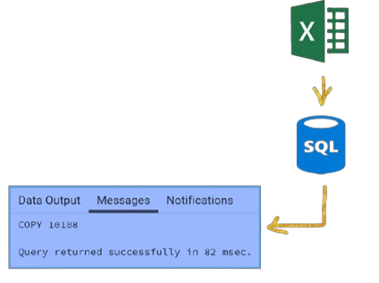
Data from SQL
Prepare csv file
Create tables in SQL
Import csv file into SQL

Slide 6

Dashboard Overview
The project includes 2 main dashboards:
Customer Analysis Dashboard
Transaction Analysis Dashboard
"Power BI dashboards use visuals and filters to analyze
revenue, customers, cards, and spending " :
Revenue trends and customer demographics
Demographics: age, gender, job, education
Card performance and spending categories
Spending by category: bills, fuel, food, travel

Slide 7
Key Insights – Customer Dashboard
Highest revenue from: Graduates & Self-employed individuals
Top 5 States: TX, NY, CA, FL, NJ
Female customers generated slightly higher revenue than males
Age group 30–40 & 60+ showed most financial activity
Highest income group contributed the most revenue

Slide 8
Key Insights – Transaction Dashboard
Major expenditures like: Bills, Entertainment & Fuel
Preferred transaction method: Swipe > Chip > Online
Revenue and transaction volume remained stable across quarters

Slide 9

Thankyou

